Slide 1
Marc Fetscherin, Ph.D.
Gelbman Family Chair of International Business
Professor of Marketing
Rollins College, USA
BRAND Love and Addiction
AND THEIR EFFECTS ON CONSUMERS' NEGATIVE BEHAVIORS

Slide 2
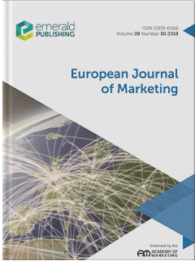
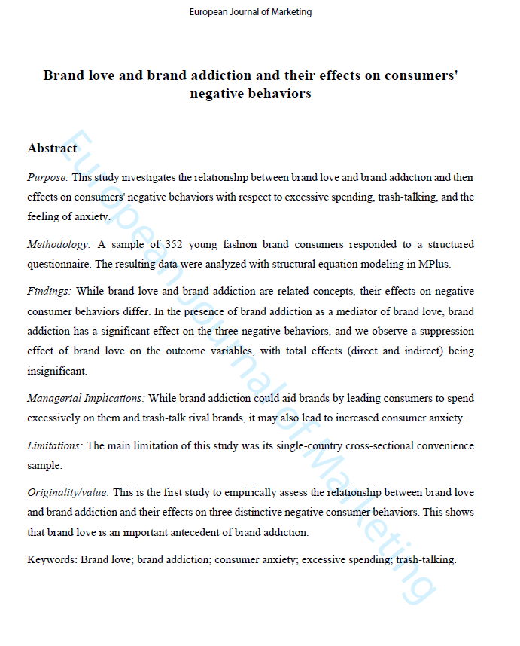
Muhammad Junaid, Marc Fetscherin, Khalid Hussain & Fujun Hou (2022). Brand love and brand addiction and their effects on consumers' negative behaviors, European Journal of Marketing, forthcoming, 10.1108/EJM-09-2019-0727

Slide 3
Love and Addiction Research
Consumer-brand relationship theory
The positive addiction theory and brand addiction
The trajectories of brand love
An overlap between brand addiction and brand love

Slide 4
Brand Love
Sternberg (1986)→ Shimp and Madden (1988)→Ahuvia (1993)→ Fournier (1998)→ Ahuvia (2005)→ Carroll and Ahuvia (2006)
Extensively being studied for its positive outcomes (e.g., positive word of mouth, brand loyalty)
Very limited insights into negative consumer outcomes as related to brand love
Carroll and Ahuvia (2006) state "the degree of passionate emotional attachment a satisfied consumer has for a particular trade name."

Slide 5
Brand Addiction
Traditionally known as a harmful relationship
More recently, a positive perspective is presented building on positive addiction theory
Brand addiction is a complex state that cannot be limited to a single, causal explanation
A central mechanism in such a process is forgiveness as it’s about restoring relationships
Lee (2020, p. 1) states that brand addiction "refers to consumers' addictive behavior, with consumers particularly loving the brand”

Slide 6
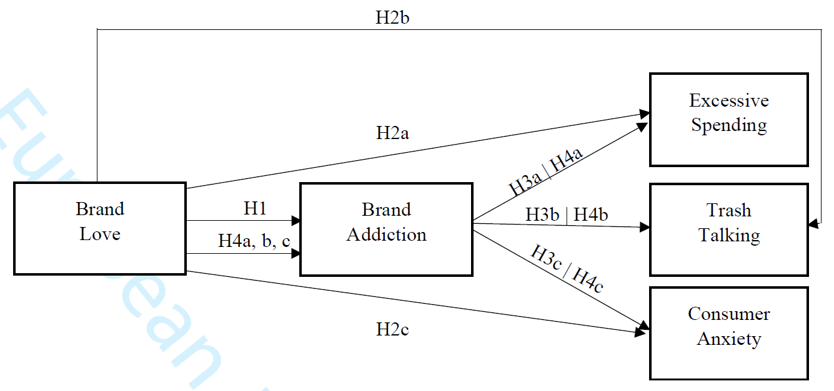
Research Model & Hypotheses
H2b
Excessive Spending
H3a I H4a
Brand Love
Brand Addiction
H1
H3b I H4b
Trash Talking
H4a,b,c
H3c I H4c
Consumer Anxiety

Slide 7
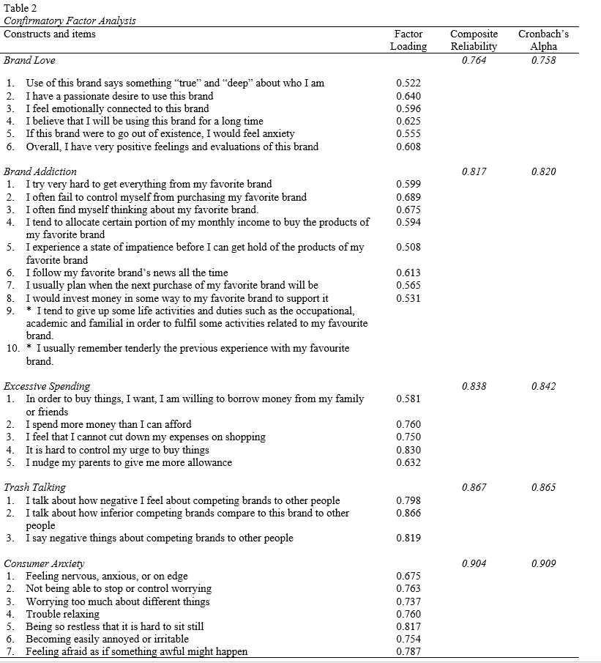
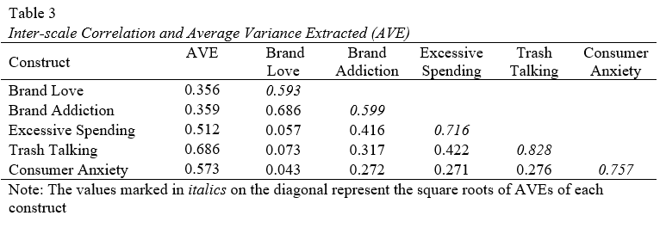
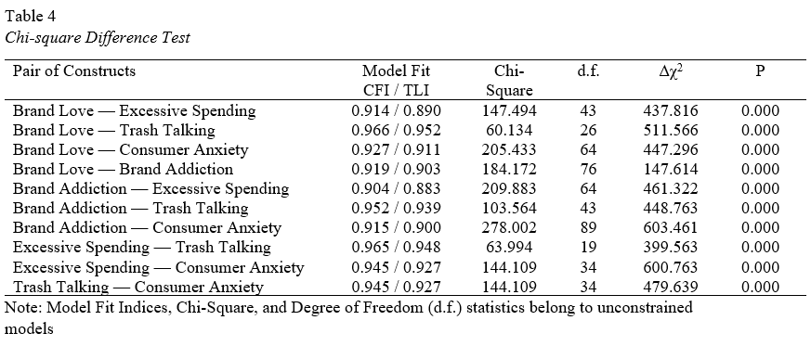
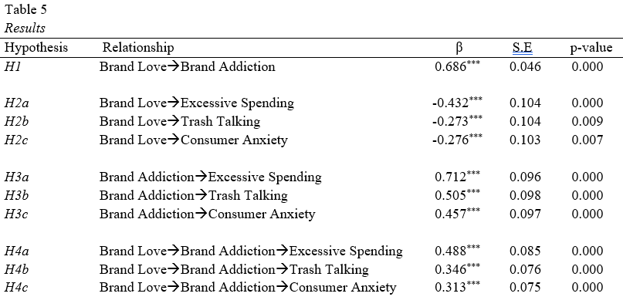
Method
Self-administered structured questionnaire survey
500 young Chinese fashion brand consumers
70.4% response rate
352 usable responses
Series of validity and reliability tests
Common method bias with
Harman’s single-factor test
Reliability, Cronbach’s a values > 0.70
CFA with item had signiﬁcant cross-loadings
Discriminant validity with Chi-square difference test
Convergent validity AVE > 0.50 and CR > 0.60
SEM and model fit indexes

Slide 8
Results Outcomes of Brand Love and Addiction
Brand love and brand addiction are related concepts and their effects on negative consumer behaviors differ
In the presence of brand addiction as a mediator of brand love, brand addiction has a significant effect on the three negative behaviors
We observe a suppression effect of brand love on the outcome variables, with total effects (direct and indirect) being insignificant

Slide 9
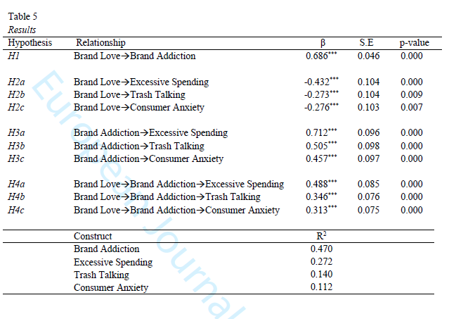
Results Brand Love
Brand love leads to brand addiction
Consumers’ love for the brand does not lead them to excessive spending, trash-talking, and anxiety
Construct | β | S.E | Sig. | Supported
H1: Brand love →Brand Addiction | 0.686*** | 0.046 | 0.000 | ✓
H2a: Brand Love → Excessive Spending | -o.432*** | 0.104 | 0.000
H2b: Brand Love→ Trash Talking | -0.273*** | 0.104 | 0.009
H2c: Brand Love → Consumer Anxiety | -0.276*** | 0.103 | 0.007

Slide 10
Results Brand Addiction
Addicted consumers tend to buy more, and trash talk
Brand addiction leads to consumer anxiety
When consumers develop an addiction to their loved brand, they go on to develop dependence, obsession, and submission to that brand, resulting in a lack of control, leading them to buy that brand in surplus, resulting in excessive spending.
Hypotheses | β | S.E | Sig. | Supported
H3a: Brand Addiction → Excessive Spending | 0.712*** | 0.096 | 0.000 | ✓
H3b: Brand Addiction → Trash Talking | 0.505*** | 0.988 | 0.000 | ✓
H3c: Brand Addiction → Consumer Anxiety | 0.457*** | 0.097 | 0.000 | ✓
H4a: Brand Love → Brand Addiction → Excessive Spending | 0.488*** | 0.085 | 0.000 | ✓
H4b: Brand Love→ Brand Addiction → Trash Talking | 0.346*** | 0.076 | 0.000 | ✓
H4c: Brand Love → Brand Addiction → Consumer Anxiety | 0.313*** | 0.075 | 0.000 | ✓

Slide 11
Conclusion
Brand love drives brand addiction, suggesting that brand addicts love their brand to the extent that it has become an unhealthy brand relationship
The brand love does not directly lead to excessive spending, trash-talking, or anxiety but brand addiction does
Brand addiction plays a significant mediating role between brand love and these negative behaviors
There is a hierarchical relationship between brand love and brand addiction, such that the latter morphing to the dark side of brand relationships performance

Slide 12
Limitations and Future Research
Love is culturally grounded. Test our model in different in a different cultural context and use a variety of sampling techniques to validate our research model
Extend model with controllable vs. non-controllable transgressions
Follow a longitudinal assessment to address dynamic aspects that could encapsulate brand lovers' trajectory toward brand addiction
Explore to what extent other measurement instruments, including multidimensional brand love scales, would validate our research model and findings
Look for consumer-related factors such as personality type, peer pressure, mental health disorder, that might contribute to the addiction to loved brands
Investigate and compare brand addiction and brand love's effects on other possible behavior outcomes, such as self-esteem, consumer well-being, consumer happiness, or social comparison

